Slide 1

SimpleEshop: Cloud-Native Architecture
Modern cloud-native e-commerce implementation
Achilles Petridis itp24105Dimitris Charitos itp24108

Slide 2

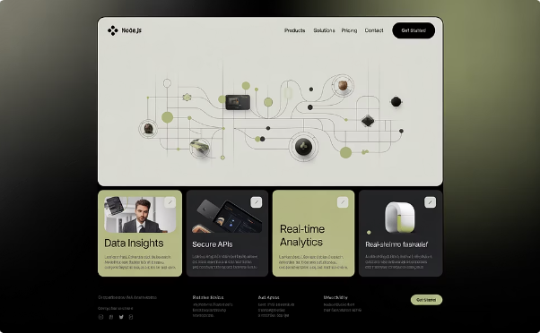

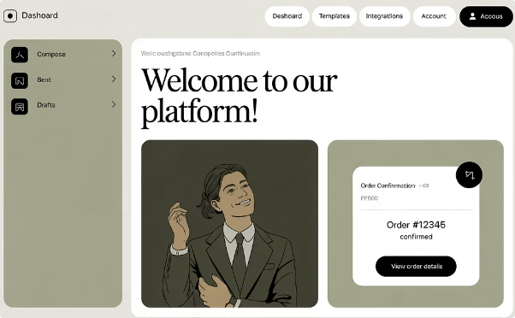
Microservices Architecture
SimpleEshop is an e-commerce platform where users can register accounts, log in securely, browse products, and place orders. The application is built with a microservices architecture for scalability and maintainability.
Web Application
Node.js-based e-commerce app with user authentication, product catalog, and order processing functionality
Data Services
PostgreSQL for user and order data, Redis for caching, Minio as S3 storage
Email Services
Automated emails for user registration and order confirmations

Slide 3

Design Patterns
1
Event-Driven Architecture
Asynchronous processing between services
2
Retry Pattern
Retry mechanism for database connections
3
Stateless-Serverless Pattern
Serverless email operations
4
Circuit Breaker Pattern
Protect against SMTP server failures

Slide 4








Technology Stack
Frontend & Backend
Data Storage
Node.js, Express.js
PostgreSQL, MinIO
CI/CD & GitOps
Containerization
Jenkins, ArgoCD, GitHub
Docker, Kubernetes, Helm

Slide 5




Infrastructure as Code
OpenTofu
Azure infrastructure provisioning
Ansible
Configuration management
Kubernetes
Container orchestration

Slide 6
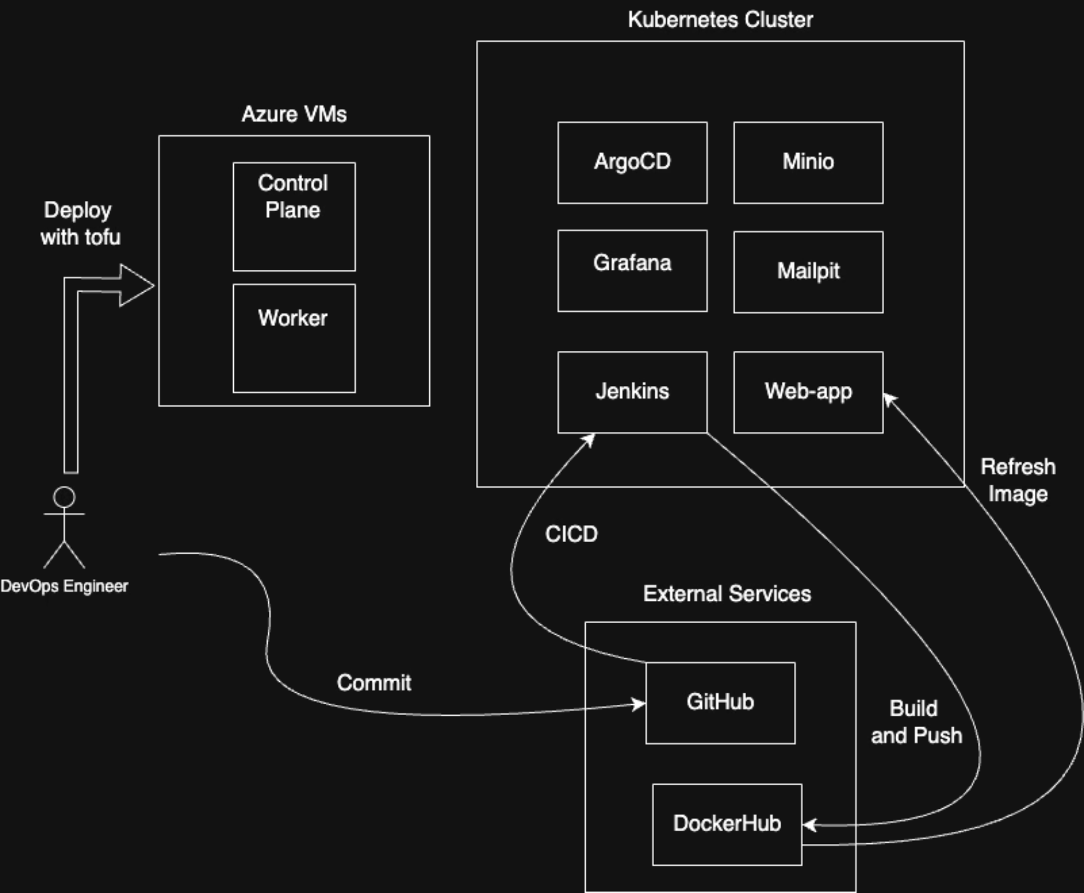
Architecture
Block Diagram
Infrastracture Deployment with OpenTofu
Ansible (microk8s deployment across VMs)
Kubernetes Cluster
CICD with Jenkins

Slide 7
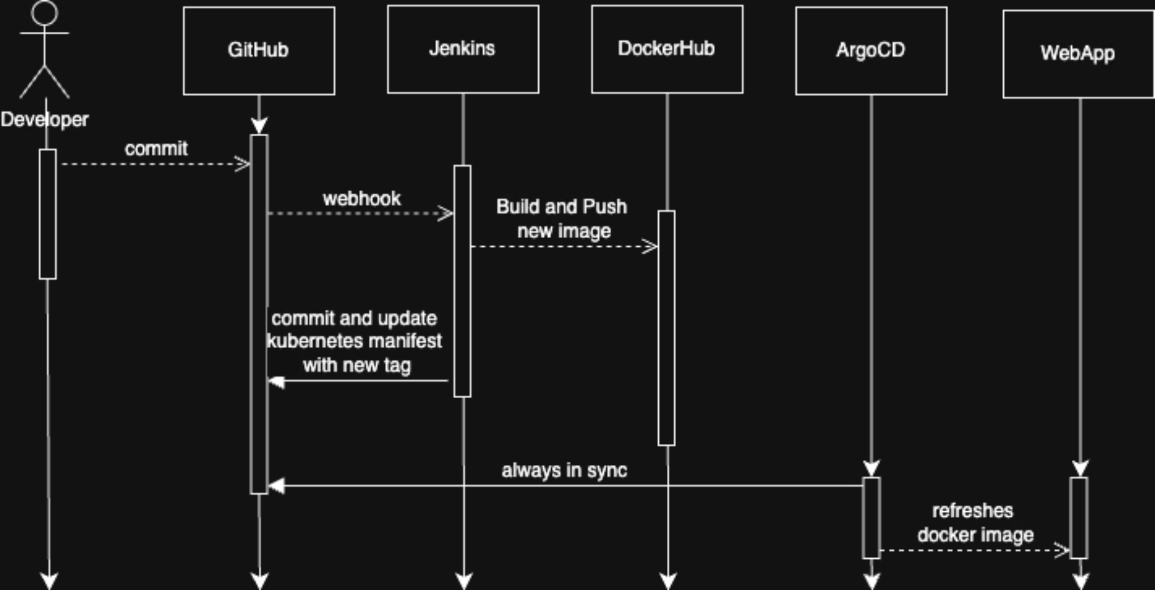
GitOps with CI/CD
Workflow Sequence Diagram
Developer GitHub commit/push
Jenkins CI/CD pipeline
Build docker image and push to DockerHub
ArgoCD for deployment
Git as single source of truth
Zero downtime updates

Slide 8
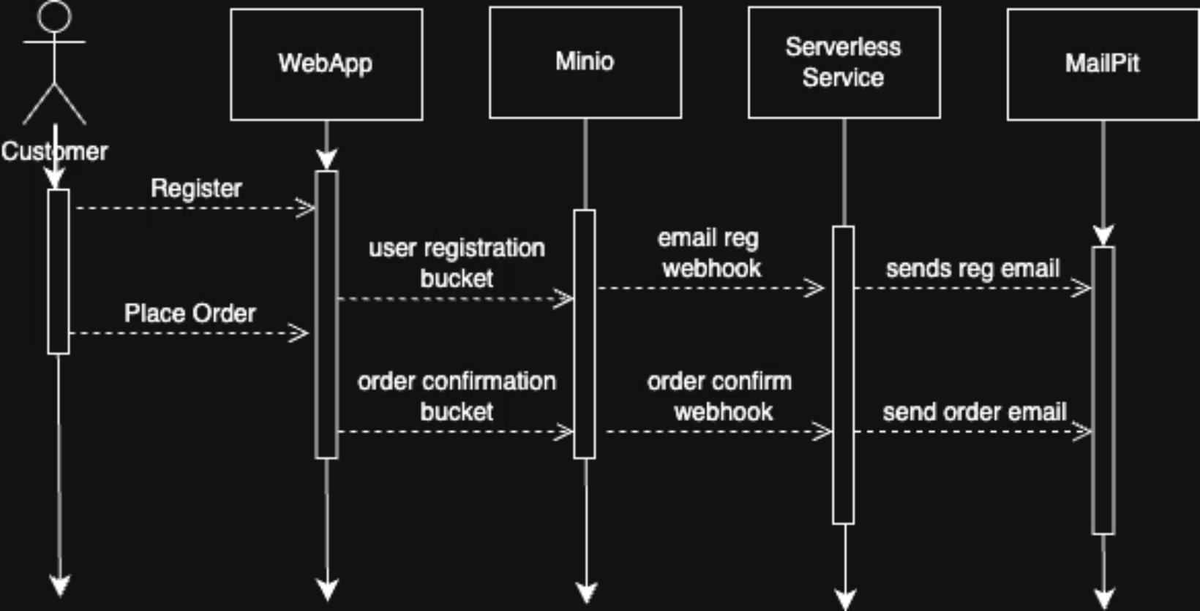
Serverless Functions
Workflow Sequence Diagram
User Registration/Place Order
Welcome Email Service
Order Confirmation Service
MinIO bucket notifications
MailPit for catching emails

Slide 9

Monitoring & Logging
Prometheus
Metrics collection and alerting
Grafana
Visualization and dashboards
Loki
Log aggregation
Promtail
Log collection agent

Slide 10

Email Services
Welcome Email Service
Triggered by user registration
Personalized content
Order Confirmation Service
Order details and invoices
Independent operation

Slide 11

Key Benefits
1
High Availability
Continuous operation with no downtime
2
Maintainability
Modular design for easier updates
3
Resilience
Fault isolation between components
4
Automation
Consistent deployment with GitOps

Slide 12

Conclusion
SimpleEshop demonstrates how cloud-native architecture enables resilient, and maintainable platforms.
Microservices Architecture
Infrastructure as Code
Decoupled services with independent lifecycles provide robustness and fault isolation.
OpenTofu, Ansible, and Kubernetes enable consistent, repeatable infrastructure deployments.
GitOps & Automation
Using Git as the single source of truth with CI/CD pipelines ensures reliable and auditable deployments.
Notes:
This concludes our presentation on SimpleEshop's cloud-native architecture. To summarize the key points: we've built a scalable system using microservices, implemented infrastructure as code for consistent deployments, and established GitOps workflows for reliable updates. Our architecture provides high availability, maintainability, resilience, and automation - all critical for modern e-commerce platforms. Any questions?

